Slide 1

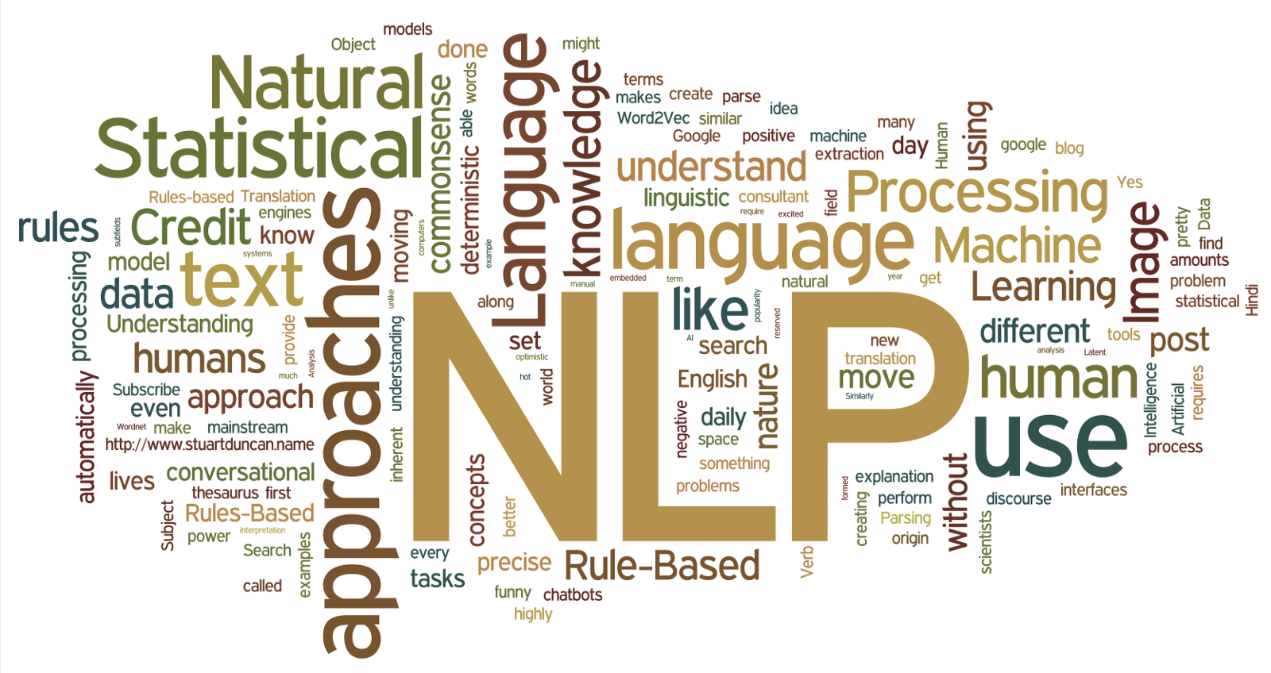
CSE431 DRAFT 1
SUICIDE RISK ASSESSMENT USING NLP AND MACHINE LEARNING
Submitted to: Annajiat Alim Rasel, Senior Lecturer, BRAC University
Submitted by:
Member 1: Hazra Mohammed Ahnaf Faiyaz , ID: 17241014
Member 2: Sadman Sakib Nabil , ID: 19101501
Group: 15
Task 4
RA: Md. Sabbir Hossain
ST: Mehnaz Ara Fazal
1

Slide 2

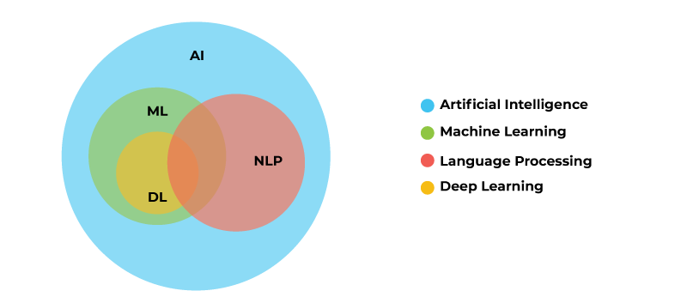
INTRODUCTION
Global Impact
Magnitude
Public Health Challenge
Understanding Triggers
Need for Research
Research Focus
Machine Learning and NLP
Scope Clarification
Fig: 1 AI , Machine Learning, and NLP [5]
2

Slide 3

RELATED WORKS
The authors of [1] tells us about depression and suicide where they implemented a similar dataset to compare different machine learning models in conjunction with NLP tasks to achieve a comprehensive outcome. In their work, they implemented various models such as SVM (Support Vector Model) and Logistic Regression to achieve an outcome.
The authors of [2] tells us about the development of two text mining applications explicitly crafted for extracting quantitative data from clinical text within psychiatric contexts. The text mining applications employ distinct Natural Language Processing (NLP) approaches aimed at identifying and classifying suicide ideation and attempts. Both approaches, evidenced by high precision and recall statistics show promising outcomes.
The authors of [3] tells us that machine algorithms, in part, perform as well as humans in distinguishing between elicited and genuine suicide notes which is good news as it can eradicate complete dependency on psychiatrists and doctors.
The authors of [4] emphasizes that NLP is improving at a fast rate and that it has the potential to help people by lowering costs in the education, finance, and even the health sectors.
3

Slide 4
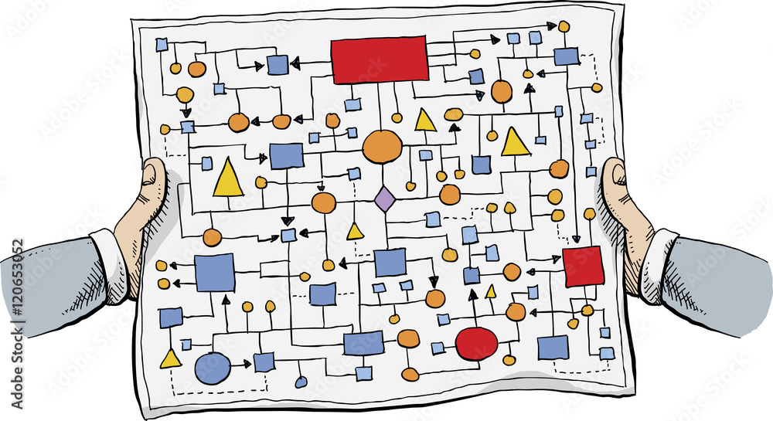
METHODOLOGY
Dataset Selection
Dataset Preprocessing
Data Loading and Overview
Text Data Cleaning and Preprocessing
Model Selection
Model Integration
Testing and Evaluation
Results Analysis
Documentation and Reporting
4

Slide 5
REFERENCES:
Jain, P., Srinivas, K. R., & Vichare, A. (2022). Depression and Suicide Analysis Using Machine Learning and NLP. Journal of Physics: Conference Series, 2161, 012034. Published under license by IOP Publishing Ltd. doi: 10.1088/1742-6596/2161/1/012034 [1]
Fernandes, A.C., Dutta, R., Velupillai, S. et al. Identifying Suicide Ideation and Suicidal Attempts in a Psychiatric Clinical Research Database using Natural Language Processing. Sci Rep 8, 7426 (2018). https://doi.org/10.1038/s41598-018-25773-2 [2]
Pestian J, Nasrallah H, Matykiewicz P, Bennett A, Leenaars A. Suicide Note Classification Using Natural Language Processing: A Content Analysis. Biomedical Informatics Insights. 2010;3. doi:10.4137/BII.S4706 [3]
Bhoi, P. C., Singh, D., & Das, B. (2023, May 9). The Recent Advances and Applications of Natural Language Processing. [4]
Bolanos , X., A. (2021, September 29). Natural Language Processing and Machine Learning. Retrieved from https://www.encora.com/insights/natural-language-processing-and-machine-learning. [5]
5

